Slide 1
Yuvanesh K M
Final Project

Slide 2

PROJECT TITLE
Chat with a Website from URL – LangChain Chatbot with Streamlit GUI

Slide 3


AGENDA
LangChain is an open-source framework designed to simplify the creation of applications using large language models (LLMs). It provides a standard interface for chains, lots of integrations with other tools, and end-to-end chains for common applications. It allows AI developers to develop applications based on the combined Large Language Models (LLMs) such as GPT-4 with external sources of computation and data. This framework comes with a package for both Python and JavaScript.
LangChain follows a general pipeline where a user asks a question to the language model where the vector representation of the question is used to do a similarity search in the vector database and the relevant information is fetched from the vector database and the response is later fed to the language model. further, the language model generates an answer or takes an action.
.
3/21/2024 Annual Review

Slide 4

PROBLEM STATEMENT
The problem statement for LangChain Framework is to create a Chatbot that takes a website link as an input and if a question is asked about the website then the chatbot is able to give precise answer about the question. In short a chatbot will learn the website and can be able to answer the questions respect to the website.

Slide 5

PROJECT OVERVIEW
The project overview is to create a chatbot using langchain framework and streamlit for GUI that will able to study any website through the provided link and can be able to answer any questions precisely regarding to the website.

Slide 6
WHO ARE THE END USERS?
Students: Students who don’t want to read the entire website but need some information from the website can use this.
Content Creators: Content creators in fields such as advertising, marketing, and entertainment who need specific information in the website can use this chatbot to get the result.
General Public and
Researchers and Developers.

Slide 7

YOUR SOLUTION AND ITS VALUE PROPOSITION
Our solution is a chatbot that will summarize the given website and it will answer your question about the website.
For example: It a Wikipedia webpage link is given to the chatbot, first it will learn the information that are present in the website and after if a question is asked about the webpage content then the chatbot is able to understand the question and it will give you the relevant answers to you.

Slide 8
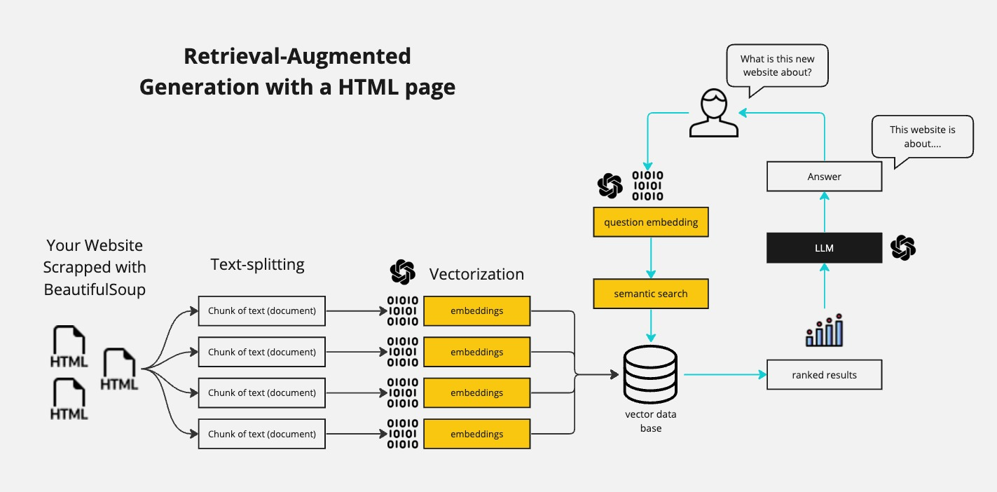
Architecture

Slide 9

THE WOW IN YOUR SOLUTION
Website Interaction: The chatbot uses the latest version of LangChain to interact with and extract information from various websites.
Large Language Model Integration: Compatibility with models like GPT-4, Mistral, Llama2, and ollama. In this code I am using GPT-4, but you can change it to any other model.
Streamlit GUI: A clean and intuitive user interface built with Streamlit, making it accessible for users with varying levels of technical expertise.
Python-based: Entirely coded in Python.
3/21/2024 Annual Review

Slide 10
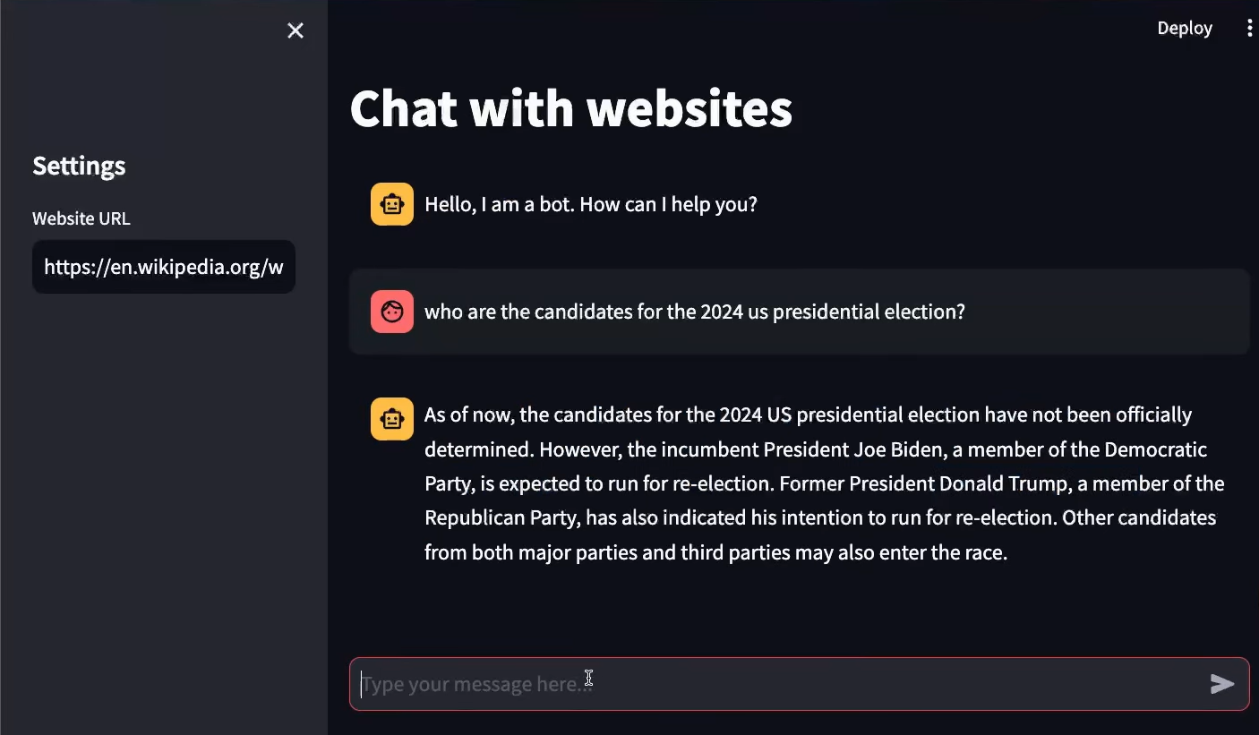
MODELLING
“Models” predominantly refers to Large Language Models (LLMs). These LLMs are characterized by their substantial size, consisting of neural networks with numerous parameters, and being trained on extensive amounts of unlabeled text data.

Slide 11
RESULTS
LangChain is a powerful framework for developing applications powered by language models. It provides a number of features that make it easier to develop applications using language models, such as a standard interface for interacting with language models, a library of pre-built tools for common tasks, and a mechanism for chaining together multiple tools to create complex applications.

